Slide 1
Hashing
Data Structures and Algorithms
Nanjing University, Fall 2024
郑朝栋

Slide 2












Quick Review
Hash Tables
Store $n$ keys from a huge universe $U$ into a table of size $m≈n$
Use a hash function $h:U→\left[m\right]$ to decide where to put each key
Collisions are inevitable!
[Collision Resolution] Method 1: Chaining.
[Collision Resolution] Method 2: Open addressing.
$$U$$
3
0
$$h\left(x\right)=0$$
1
$$h\left(u\right)=2$$
2
3
3
$$x$$
$$u$$
$$h\left(y\right)=5$$
4
$$y$$
5
$$w$$
3
6
$$h\left(z\right)=8$$
$$h\left(w\right)=8$$
7
$$z$$
8

Slide 3
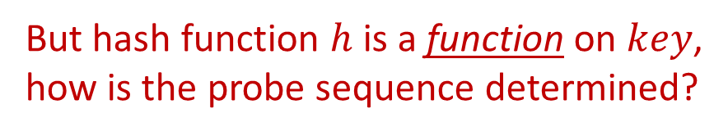


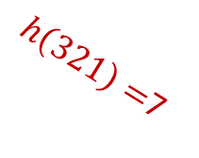
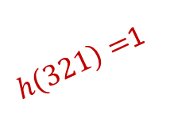

Coping with collisions in hashing Open Addressing
Basic idea:
No linked lists!
All items store in the table, one item per bucket!
Load factor $α=\frac{n}{m}≤1$
On collision?
Probe a sequence of buckets until an empty one is found!
3
0
245
1
$h\left(321\right)=$1
2
$$key=321$$
$h\left(321\right)=$4
366
3
$h\left(321\right)=$7
321
4
111
5
3
6
571
7
533
8
But hash function $h$ is a function on $key$, how is the probe sequence determined?
Notes:
Open addressing: 开放寻址

Slide 4

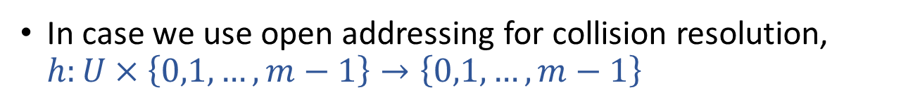
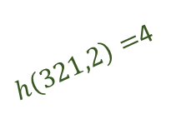

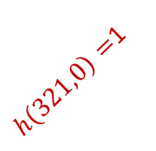
Open addressing Hash Function Re-defined
In case we use open addressing for collision resolution, $h:U×\left\{0,1,…,m−1\right\}→\left\{0,1,…,m−1\right\}$
key
probe number
table index
HashInsert(T,k):
i=0
repeat
j=h(k,i)
if (T[j]==NIL)
T[j]=k
return j
else i=i+1
until (i==m)
return “overflow”
HashSearch(T,k):
i=0
repeat
j=h(k,i)
if (T[j]==k)
return j
i=i+1
until (i==m or T[j]==NIL)
return NIL
3
0
245
1
$h\left(321,0\right)=$1
2
366
3
$h\left(321,2\right)=$4
321
4
111
5
$$key=321$$
3
6
$h\left(321,1\right)=$7
571
7
533
8

Slide 5

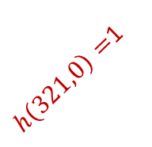




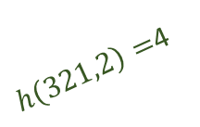
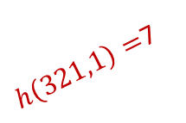

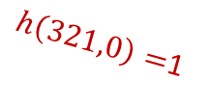
Open addressing The Remove Operation
HashInsert(T,k):
i=0
repeat
j=h(k,i)
if (T[j]==NIL)
T[j]=k
return j
else i=i+1
until (i==m)
return “overflow”
HashSearch(T,k):
i=0
repeat
j=h(k,i)
if (T[j]==k)
return j
i=i+1
until (i==m or T[j]==NIL)
return NIL
HashRemove(T,k):
pos=HashSearch(T,k)
if (pos!=NIL)
T[pos]=NIL
return pos
No change!
WRONG!!!
HashRemove(T,k):
pos=HashSearch(T,k)
if (pos!=NIL)
T[pos]=DEL
return pos
T[j]==NIL or T[j]==DEL
3
0
$h\left(245,0\right)=$1
Remove $245$
245
1
DEL
$h\left(321,0\right)=$1
2
$h\left(321,0\right)=$1
366
3
$h\left(321,2\right)=$4
Search $321$
$h\left(321,2\right)=$4
321
4
111
5
$h\left(321,1\right)=$7
Insert $321$
3
6
$h\left(321,1\right)=$7
571
7
533
8

Slide 6
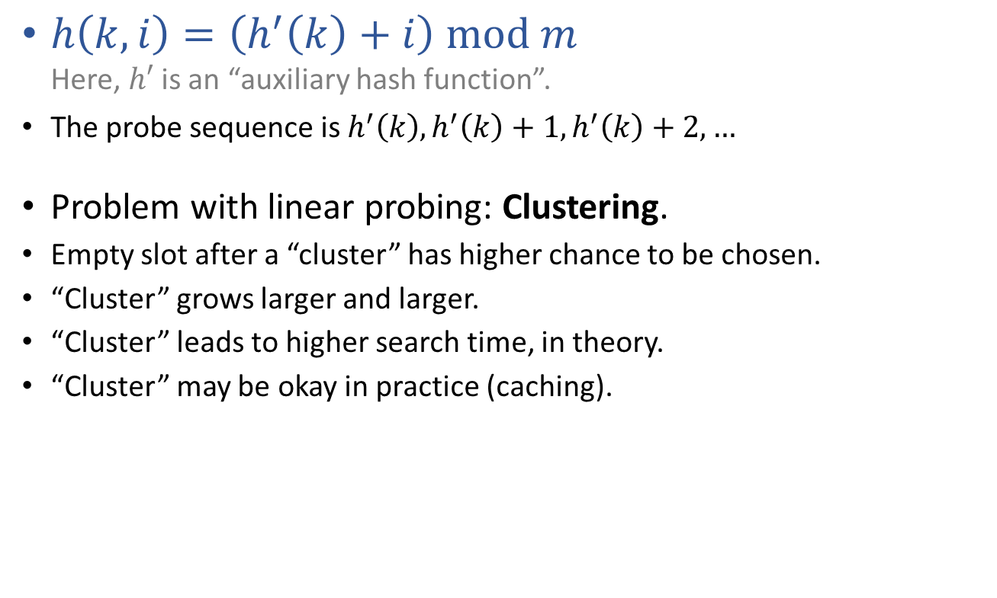
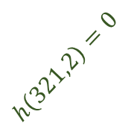

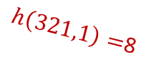

Commonly used probing sequences Linear Probing
$h\left(k,i\right)=\left(h^{′}\left(k\right)+i\right) mod m$ Here, $h′$ is an “auxiliary hash function”.
The probe sequence is $h^{′}\left(k\right),h^{′}\left(k\right)+1,h^{′}\left(k\right)+2,…$
Problem with linear probing: Clustering.
Empty slot after a “cluster” has higher chance to be chosen.
“Cluster” grows larger and larger.
“Cluster” leads to higher search time, in theory.
“Cluster” may be okay in practice (caching).
321
0
1
2
$$h\left(321,2\right)=0$$
366
3
689
4
111
5
Insert $321$
$h\left(321,0\right)=$7
3
6
571
7
$h\left(321,1\right)=$8
533
8
Notes:
Linear probing: 线性探查

Slide 7
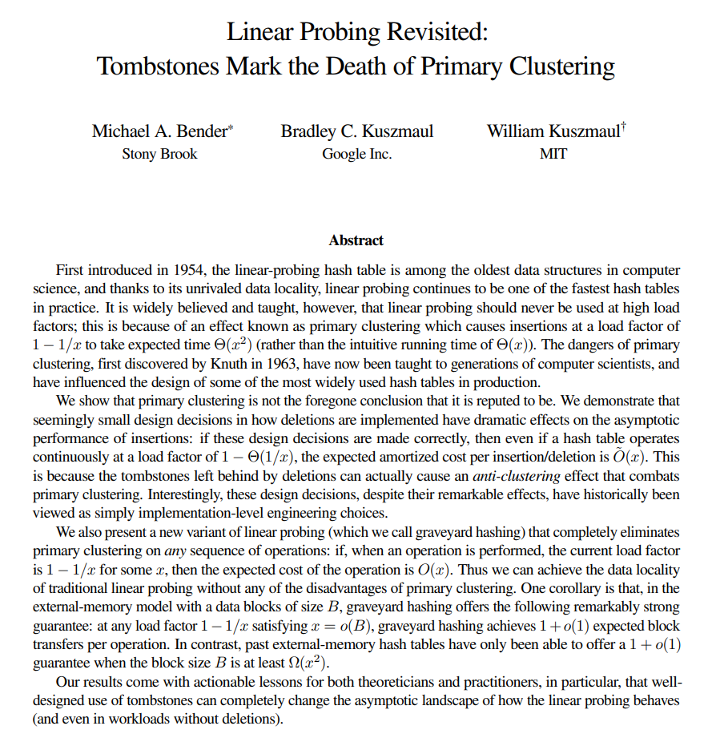



The remove mechanism (i.e., the DEL mark, the “tombstone”) causes “anti-clustering” effect, improving the performance of linear-probing hash tables.
Presented at FOCS 2021, full version available at: https://arxiv.org/abs/2107.01250

Slide 8

Commonly used probing sequences Quadratic Probing
$h\left(k,i\right)=\left(h^{′}\left(k\right)+c_{1}i+c_{2}i^{2}\right) mod m$ Here, $h′$ is an “auxiliary hash function”.
Problem with quadratic probing: (Secondary) Clustering.
Keys having same $h′$ values result in same probe sequences.
Notes:
Quadratic probing: 二次探查

Slide 9
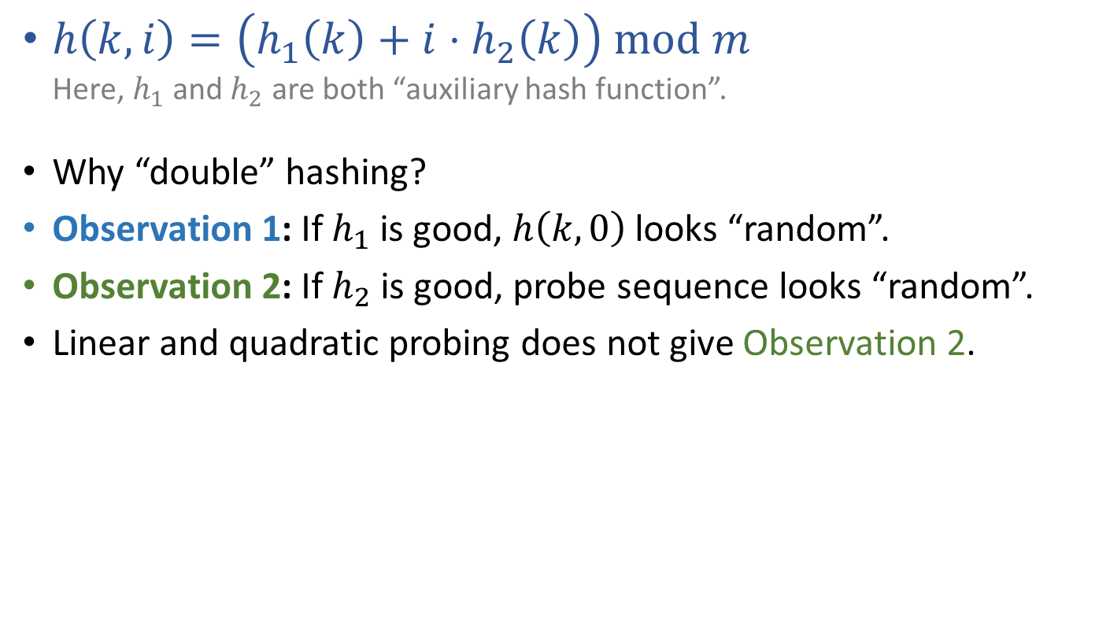
Commonly used probing sequences Double Hashing
$h\left(k,i\right)=\left(h_{1}\left(k\right)+i⋅h_{2}\left(k\right)\right) mod m$ Here, $h_{1}$ and $h_{2}$ are both “auxiliary hash function”.
Why “double” hashing?
Observation 1: If $h_{1}$ is good, $h\left(k,0\right)$ looks “random”.
Observation 2: If $h_{2}$ is good, probe sequence looks “random”.
Linear and quadratic probing does not give Observation 2.
Notes:
Double hashing: 双重哈希（散列）

Slide 10
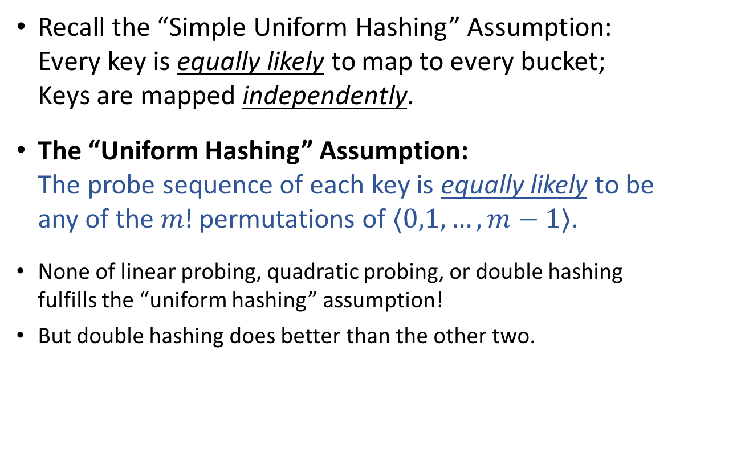
Performance of open-address hashing The “Uniform Hashing” Assumption
Recall the “Simple Uniform Hashing” Assumption: Every key is equally likely to map to every bucket; Keys are mapped independently.
The “Uniform Hashing” Assumption: The probe sequence of each key is equally likely to be any of the $m!$ permutations of $⟨0,1,…,m−1⟩$.
None of linear probing, quadratic probing, or double hashing fulfills the “uniform hashing” assumption!
But double hashing does better than the other two.

Slide 11
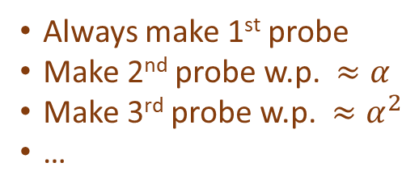
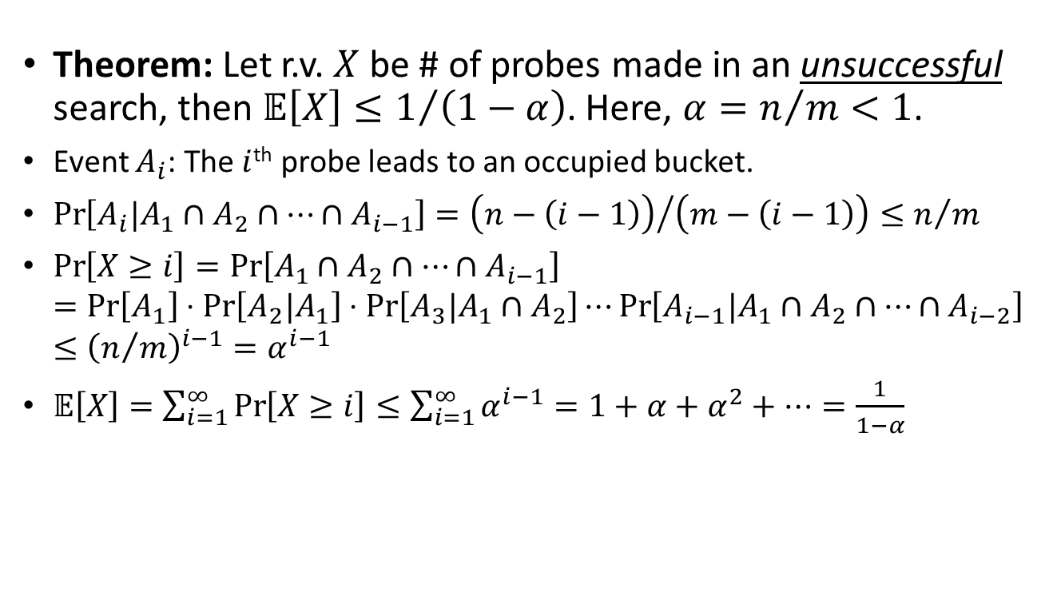
Assuming “uniform hashing” Performance of open-address hashing
Theorem: Let r.v. $X$ be # of probes made in an unsuccessful search, then $𝔼\left[X\right]≤1/{\left(1−α\right)}$. Here, $α=n/m<1$.
Event $A_{i}$: The $i$^{th} probe leads to an occupied bucket.
$\operatorname{Pr}\left[A_{i}|A_{1}∩A_{2}∩…∩A_{i−1}\right]={\left(n−\left(i−1\right)\right)}/{\left(m−\left(i−1\right)\right)}≤n/m$
$\operatorname{Pr}\left[X≥i\right]=\operatorname{Pr}\left[A_{1}∩A_{2}∩…∩A_{i−1}\right]$ $=\operatorname{Pr}\left[A_{1}\right]⋅\operatorname{Pr}\left[A_{2}|A_{1}\right]⋅\operatorname{Pr}\left[A_{3}|A_{1}∩A_{2}\right]⋯\operatorname{Pr}\left[A_{i−1}|A_{1}∩A_{2}∩…∩A_{i−2}\right]$ $≤{\left(n/m\right)}^{i−1}=α^{i−1}$
$𝔼\left[X\right]=\sum_{i=1}^{∞}{\operatorname{Pr}\left[X≥i\right]}≤\sum_{i=1}^{∞}{α^{i−1}}=1+α+α^{2}+…=\frac{1}{1−α}$
Always make 1st probe
Make 2nd probe w.p. $≈α$
Make 3rd probe w.p. $≈α^{2}$
…

Slide 12
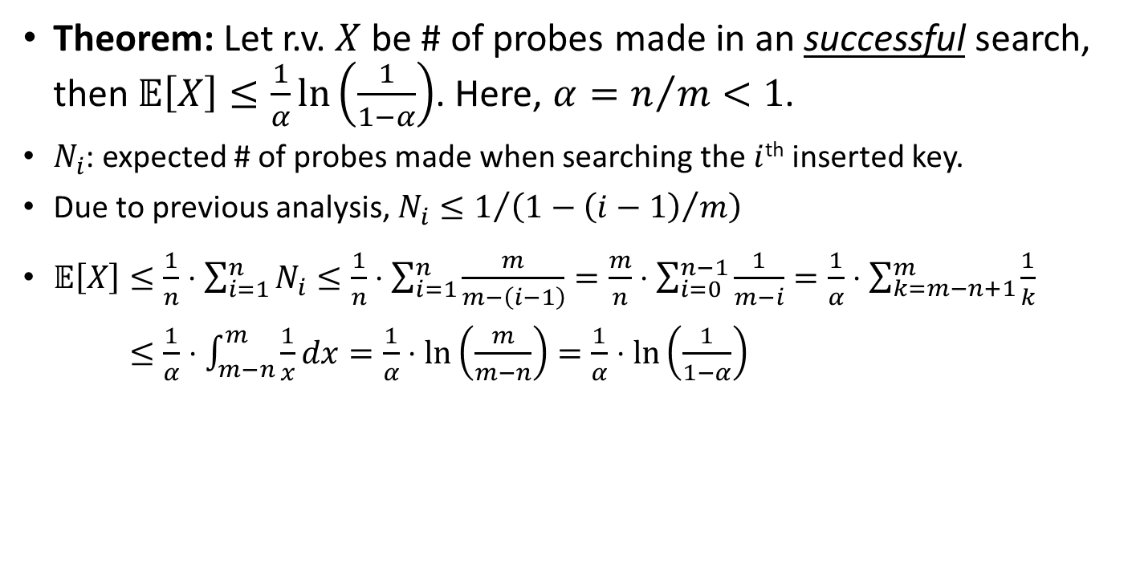
Assuming “uniform hashing” Performance of open-address hashing
Theorem: Let r.v. $X$ be # of probes made in an successful search, then $𝔼\left[X\right]≤\frac{1}{α}\ln\left(\frac{1}{1−α}\right)$. Here, $α=n/m<1$.
$N_{i}$: expected # of probes made when searching the $i$^{th} inserted key.
Due to previous analysis, $N_{i}≤1/{\left(1−{\left(i−1\right)}/m\right)}$
$𝔼\left[X\right]≤\frac{1}{n}⋅\sum_{i=1}^{n}{N_{i}}≤\frac{1}{n}⋅\sum_{i=1}^{n}{\frac{m}{m−\left(i−1\right)}}=\frac{m}{n}⋅\sum_{i=0}^{n−1}{\frac{1}{m−i}}=\frac{1}{α}⋅\sum_{k=m−n+1}^{m}{\frac{1}{k}}$ $𝔼\left[X\right]≤\frac{1}{α}⋅\int_{m−n}^{m}{\frac{1}{x}dx}=\frac{1}{α}⋅\ln\left(\frac{m}{m−n}\right)=\frac{1}{α}⋅\ln\left(\frac{1}{1−α}\right)$

Slide 13
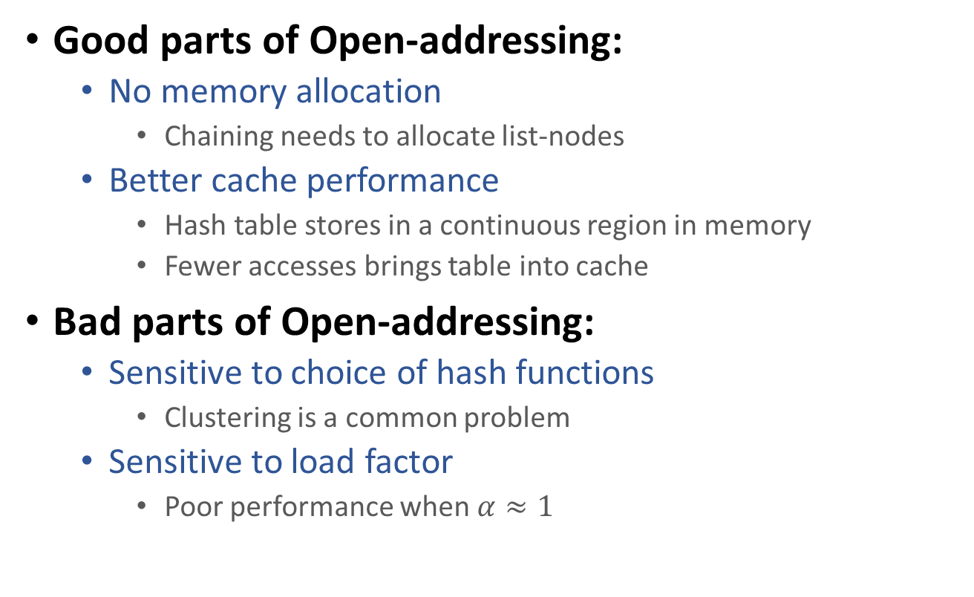
Collision resolution in hashing Chaining vs Open-addressing
Good parts of Open-addressing:
No memory allocation
Chaining needs to allocate list-nodes
Better cache performance
Hash table stores in a continuous region in memory
Fewer accesses brings table into cache
Bad parts of Open-addressing:
Sensitive to choice of hash functions
Clustering is a common problem
Sensitive to load factor
Poor performance when $α≈1$

Slide 14
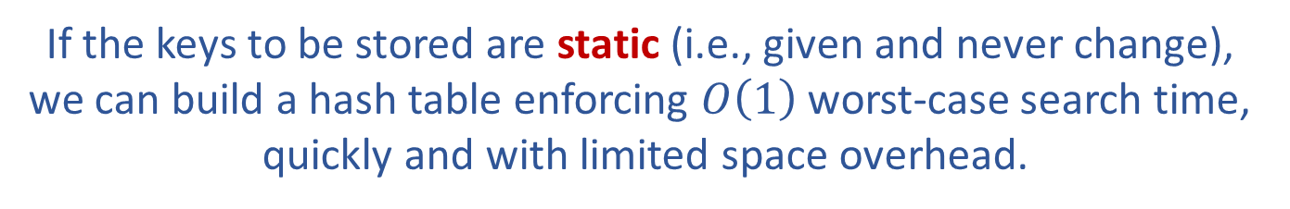
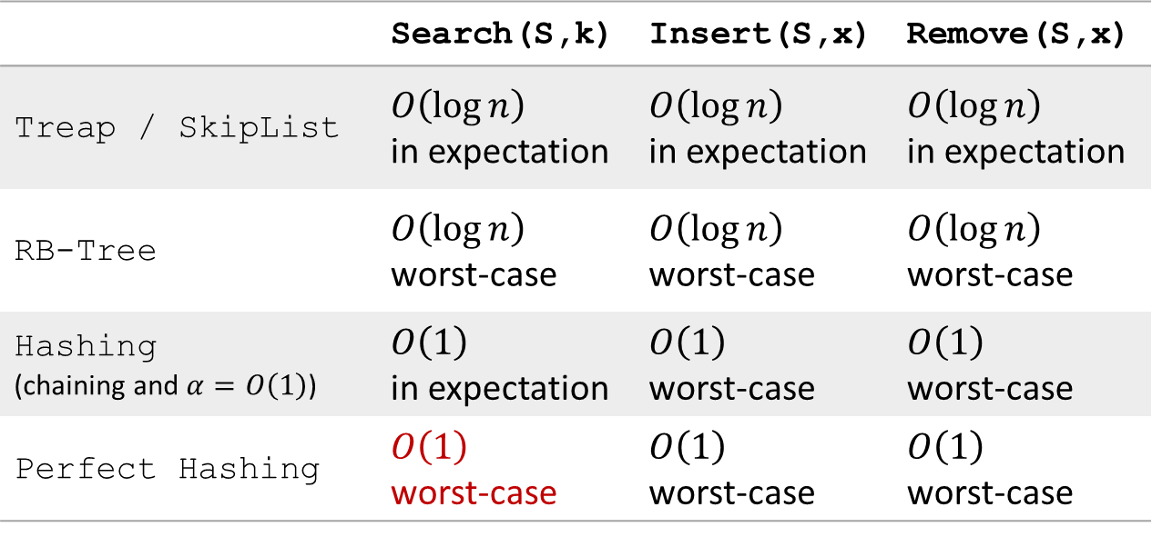
Efficient implementation of OSet
 | Search(S,k) | Insert(S,x) | Remove(S,x)
Treap / SkipList | $O\left(\log{n}\right)$ in expectation | $O\left(\log{n}\right)$ in expectation | $O\left(\log{n}\right)$ in expectation
RB-Tree | $O\left(\log{n}\right)$ worst-case | $O\left(\log{n}\right)$ worst-case | $O\left(\log{n}\right)$ worst-case
Hashing (chaining and $α=O\left(1\right)$) | $O\left(1\right)$ in expectation | $O\left(1\right)$ worst-case | $O\left(1\right)$ worst-case
Perfect Hashing | $O\left(1\right)$ worst-case | $O\left(1\right)$ worst-case | $O\left(1\right)$ worst-case
If the keys to be stored are static (i.e., given and never change), we can build a hash table enforcing $O\left(1\right)$ worst-case search time, quickly and with limited space overhead.

Slide 15
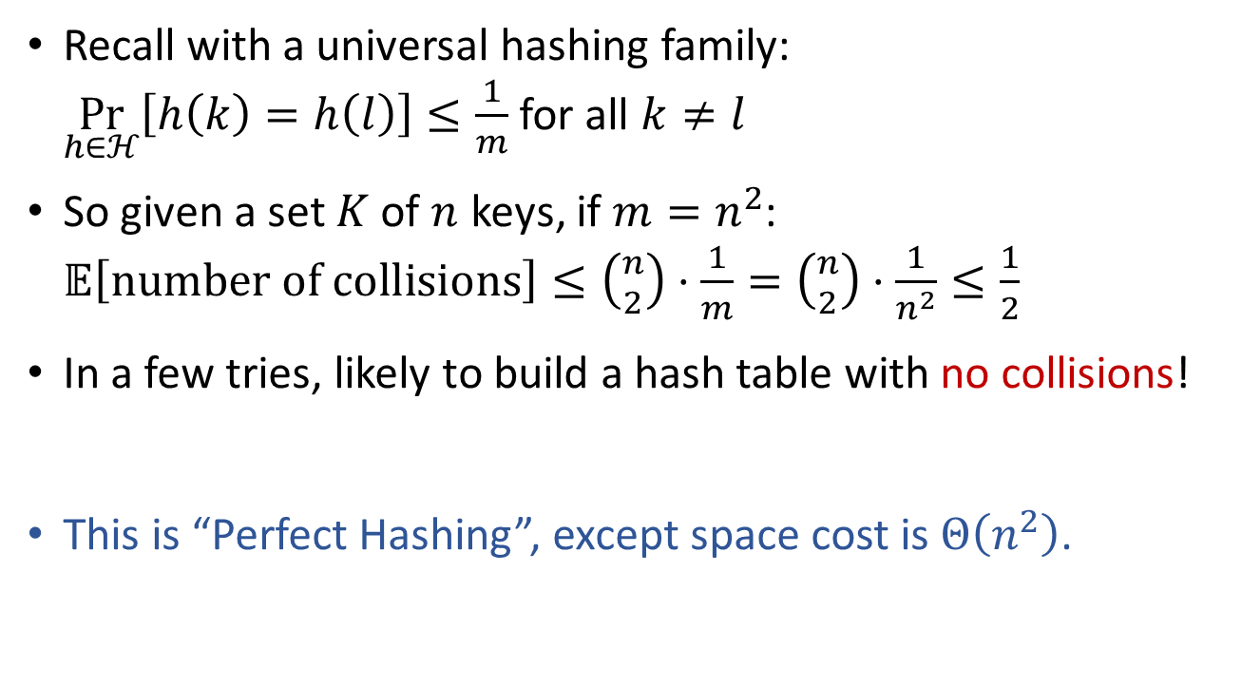

HashTable of size $Θ\left(n^{2}\right)$
Recall with a universal hashing family: $\underset{h∈ℋ}{Pr}\left[h\left(k\right)=h\left(l\right)\right]≤\frac{1}{m}$ for all $k≠l$
So given a set $K$ of $n$ keys, if $m=n^{2}$: $𝔼\left[number of collisions\right]≤\left({n \atop 2}\right)⋅\frac{1}{m}=\left({n \atop 2}\right)⋅\frac{1}{n^{2}}≤\frac{1}{2}$
In a few tries, likely to build a hash table with no collisions!
This is “Perfect Hashing”, except space cost is $Θ\left(n^{2}\right)$.

Slide 16



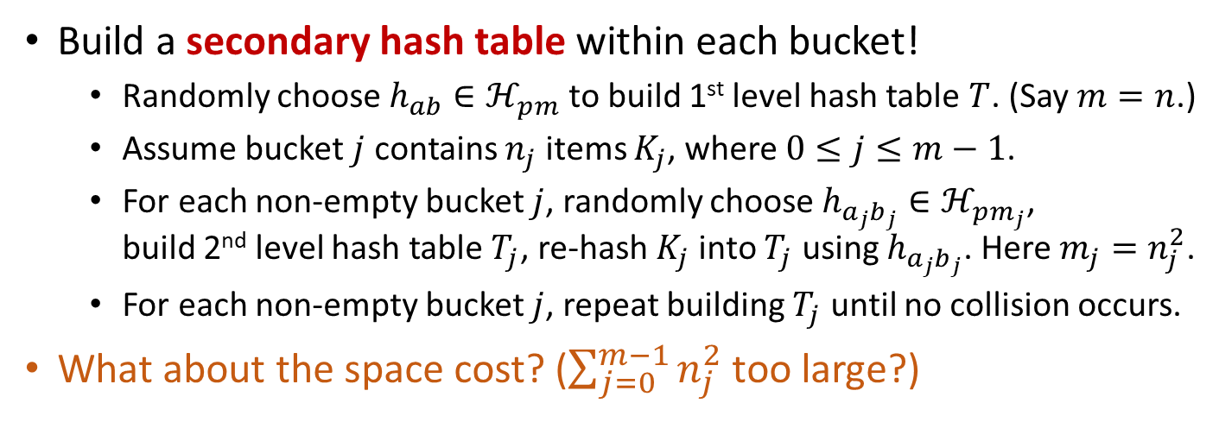



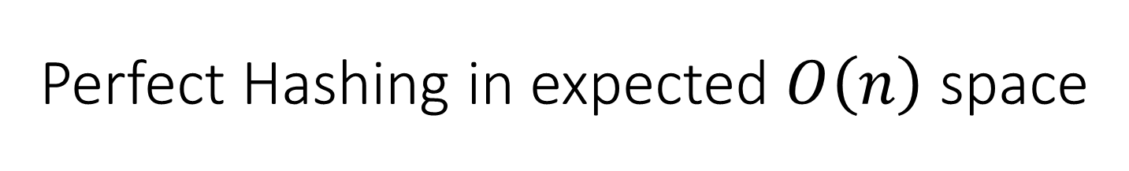









Perfect Hashing in expected $O\left(n\right)$ space
Build a secondary hash table within each bucket!
Randomly choose $h_{ab}∈ℋ_{pm}$ to build 1st level hash table $T$. (Say $m=n$.)
Assume bucket $j$ contains $n_{j}$ items $K_{j}$, where $0≤j≤m−1$.
For each non-empty bucket $j$, randomly choose $h_{a_{j}b_{j}}∈ℋ_{pm_{j}}$, build 2nd level hash table $T_{j}$, re-hash $K_{j}$ into $T_{j}$ using $h_{a_{j}b_{j}}$. Here $m_{j}=n_{j}^{2}$.
For each non-empty bucket $j$, repeat building $T_{j}$ until no collision occurs.
What about the space cost? ($\sum_{j=0}^{m−1}{n_{j}^{2}}$ too large?)
This is not hard…
0
0
1
$$k_{6}$$
$$k_{5}$$
$$k_{4}$$
1
$$\left(a_{1},b_{1},m_{1}\right)$$
$$k_{5}$$
$$k_{4}$$
$$k_{6}$$
2
2
3
3
$$k_{1}$$
3
$$\left(a_{3},b_{3},m_{3}\right)$$
$$k_{1}$$
4
3
4
5
$$k_{3}$$
$$k_{2}$$
5
$$\left(a_{5},b_{5},m_{5}\right)$$
$$k_{3}$$
$$k_{2}$$

Slide 17
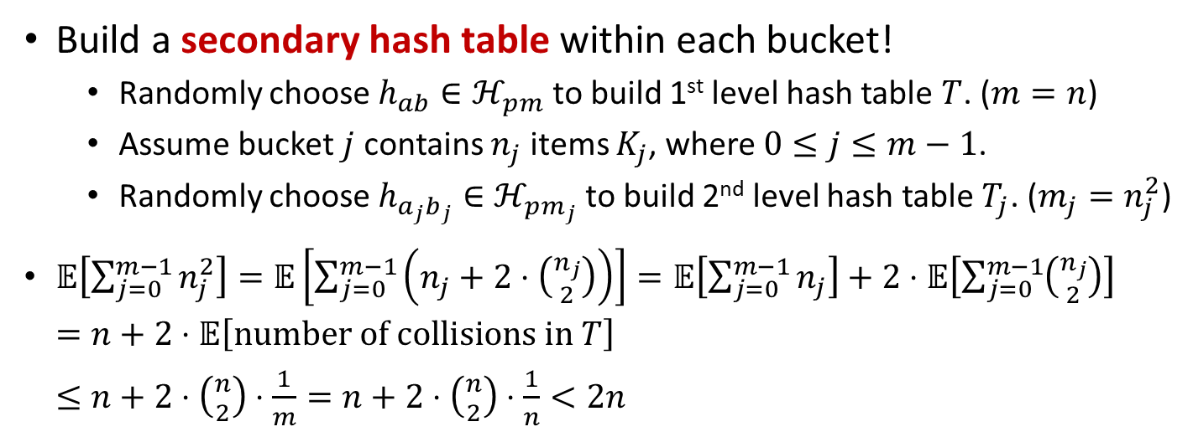
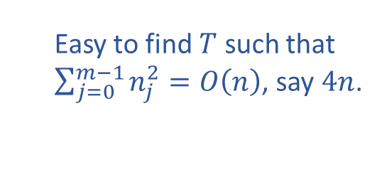
Perfect Hashing in expected $O\left(n\right)$ space
Build a secondary hash table within each bucket!
Randomly choose $h_{ab}∈ℋ_{pm}$ to build 1st level hash table $T$. ($m=n$)
Assume bucket $j$ contains $n_{j}$ items $K_{j}$, where $0≤j≤m−1$.
Randomly choose $h_{a_{j}b_{j}}∈ℋ_{pm_{j}}$ to build 2nd level hash table $T_{j}$. ($m_{j}=n_{j}^{2}$)
$𝔼\left[\sum_{j=0}^{m−1}{n_{j}^{2}}\right]=𝔼\left[\sum_{j=0}^{m−1}{\left(n_{j}+2⋅\left({n_{j} \atop 2}\right)\right)}\right]=𝔼\left[\sum_{j=0}^{m−1}{n_{j}}\right]+2⋅𝔼\left[\sum_{j=0}^{m−1}{\left({n_{j} \atop 2}\right)}\right]$ $=n+2⋅𝔼\left[number of collisions in T\right]$ $≤n+2⋅\left({n \atop 2}\right)⋅\frac{1}{m}=n+2⋅\left({n \atop 2}\right)⋅\frac{1}{n}<2n$
Easy to find $T$ such that $\sum_{j=0}^{m−1}{n_{j}^{2}}=O\left(n\right)$, say $4n$.
0
0
1
$$k_{6}$$
$$k_{5}$$
$$k_{4}$$
1
$$\left(a_{1},b_{1},m_{1}\right)$$
$$k_{5}$$
$$k_{4}$$
$$k_{6}$$
2
2
3
3
$$k_{1}$$
3
$$\left(a_{3},b_{3},m_{3}\right)$$
$$k_{1}$$
4
3
4
5
$$k_{3}$$
$$k_{2}$$
5
$$\left(a_{5},b_{5},m_{5}\right)$$
$$k_{3}$$
$$k_{2}$$

Slide 18
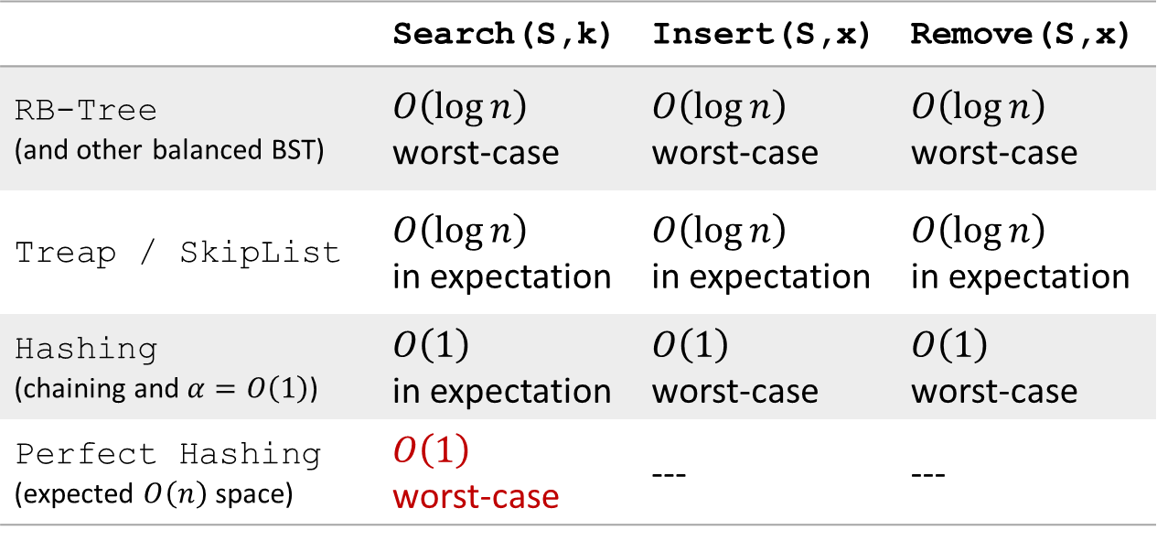
Efficient implementation of OSet
 | Search(S,k) | Insert(S,x) | Remove(S,x)
RB-Tree (and other balanced BST) | $O\left(\log{n}\right)$ worst-case | $O\left(\log{n}\right)$ worst-case | $O\left(\log{n}\right)$ worst-case
Treap / SkipList | $O\left(\log{n}\right)$ in expectation | $O\left(\log{n}\right)$ in expectation | $O\left(\log{n}\right)$ in expectation
Hashing (chaining and $α=O\left(1\right)$) | $O\left(1\right)$ in expectation | $O\left(1\right)$ worst-case | $O\left(1\right)$ worst-case
Perfect Hashing (expected $O\left(n\right)$ space) | $O\left(1\right)$ worst-case | --- | ---
Hashing can also be used for unordered Set ADT

Slide 19

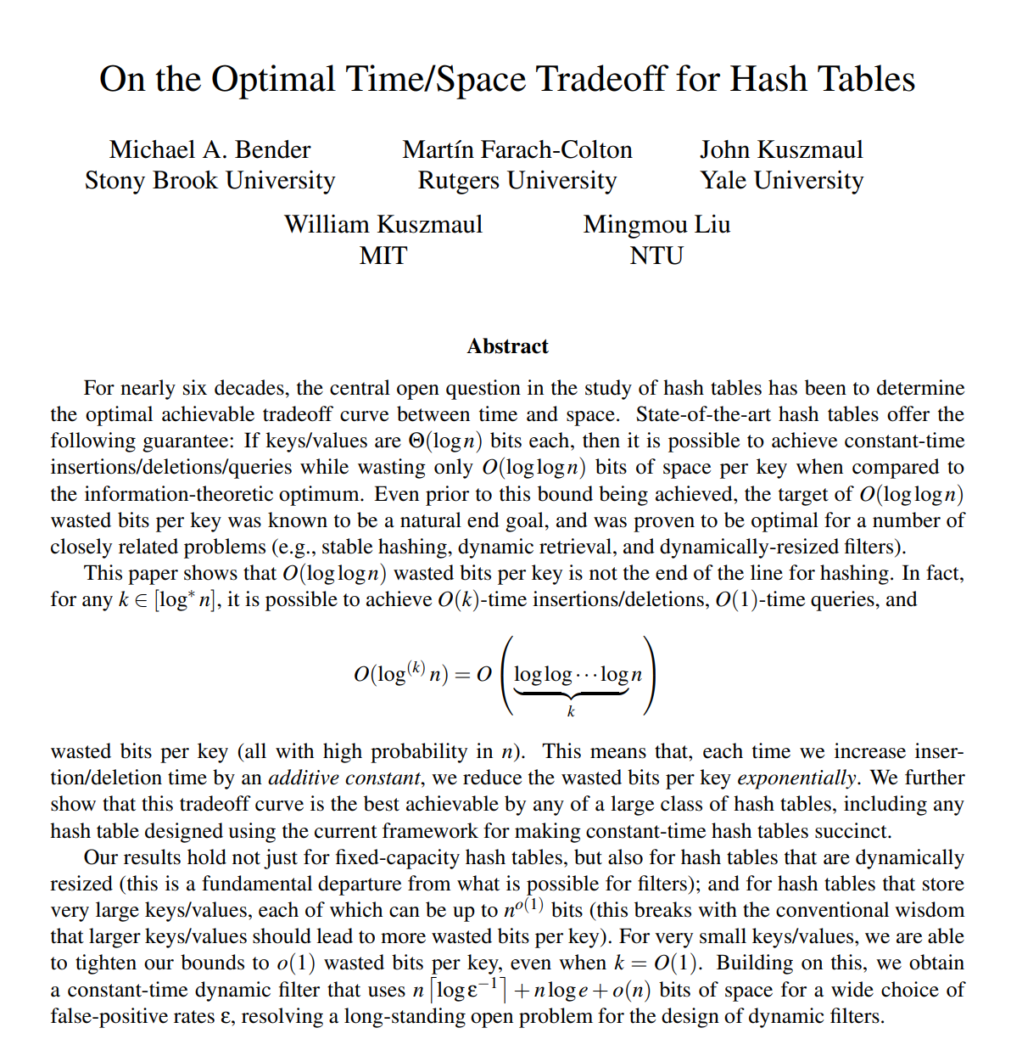
Presented at STOC 2022, full version available at: https://arxiv.org/abs/2111.00602

Slide 20
Reading
[CLRS] Ch.11 (11.4-11.5)

